Slide 1



Dark Matter and the Big Bang
David Toback
Texas A&M University
Mitchell Institute for Fundamental Physics and Astronomy
TedX TAMU
April 2015

Slide 2
Overview
We live in a time of remarkable scientific understanding
Scientists are arrogant/crazy enough to think that it may be possible to solve major problems in Astronomy, Cosmology and Particle Physics with a single discovery that ties all three together
Idea: Dark Matter is a new particle that was created right after the Big Bang and has had a major impact on the evolution of the Universe and the stuff in it

Slide 3
Notes…
(Apologies for the simplistic definitions)
Astronomy is the study of things we can see through telescopes… Stuff in Universe (space)
Cosmology is about trying to understand the origin and evolution of the Universe
Particle Physics is about trying to understand the smallest things that make up the stuff in the Universe

Slide 4
What is “Dark Matter”
As early as the 1930’s astronomers looking at galaxies realized that something was amiss
They knew enough about gravity (from Newton and Einstein) to know that the stars moving in galaxies were moving so fast that the mass of the other stars wasn’t enough to keep them in orbit
There was a lot of mass, or matter, out there that we couldn’t see. In other words it was “dark”

Slide 5
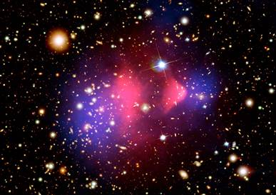
Fun Recent Evidence that Dark Matter is a particle from Colliding Clusters of Galaxies
Red part from observing the light
“Slow ➔Atoms”
Blue is the part from lensing only
“Fast ➔ Dark Matter”

Slide 6
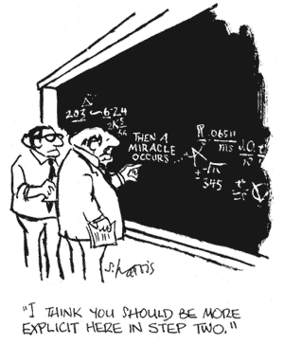
It all started with a Big Bang…
Bang…
Ok… Then what?
How did we get from the bang to the Universe we have today?

Slide 7

A Brief History of Time
Zero
One millionth of one second after the Bang
A few minutes
A few hundred thousand years
100 million to 1 billion years
9 billion years
~13.7 billion years
The Big Bang → produces lots of particles
Quarks combine to form protons and neutrons
Protons and Neutrons combine to form the nucleus of an atom
Nuclei and electrons combine to form atoms
Atoms combine to form Stars and Galaxies
The Earth and our solar system forms
You listen to me talk
What’s Missing?
When did the Dark Matter
Show up?
Clearly has had a major impact on the formation of structure in the universe, as well as the assembly of galaxies

Slide 8
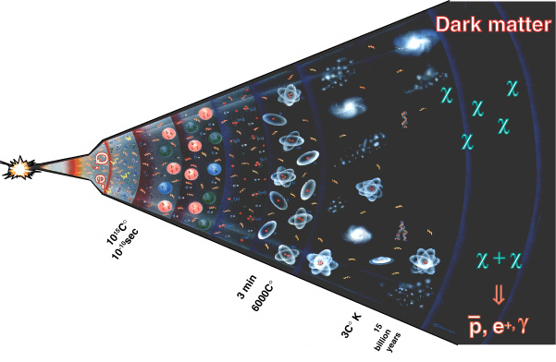
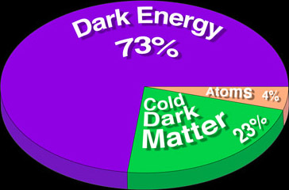
Cosmological Connections Allow for Predictions
Astronomy, Cosmology and Particle Physics:
Hypothesis: The Dark Matter in the Universe is made up of LOTS of particles that we haven’t discovered yet!
Got created in the Early Universe like everything else and is still here today!
Many theories of particle physics and cosmology allow us to make predictions of how much dark matter we should see today

Slide 9
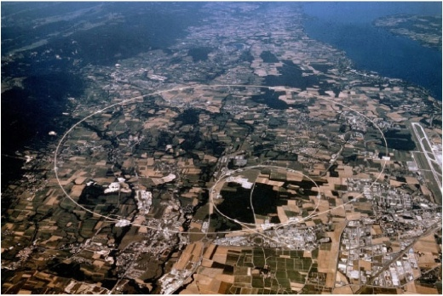
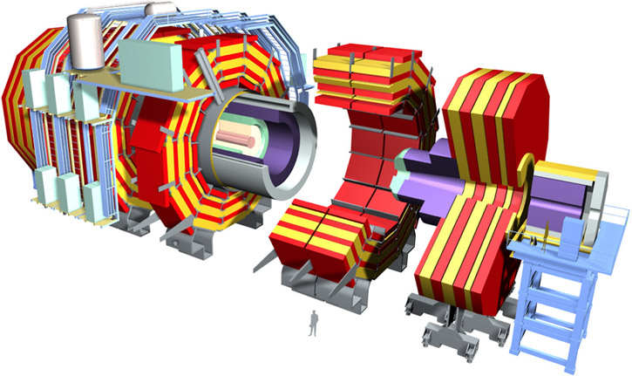
Can we Make and Discover Dark Matter?
High energy collisions between particles in the Early Universe
Recreate the conditions like they were RIGHT AFTER the Big Bang
If we can produce Dark Matter in a collision then we can STUDY it

Slide 10
Aerial View of the LHC
Lake Leman
Geneva Airport
27 km in Circumference!
One of the largest and
the most complex scientific
instrument ever conceived &
built by humankind
Collides high
energy protons
Two huge detectors
CMS
p
p
ATLAS

Slide 11
Expensive Dark Matter?
High Energy Collisions → Dark Matter Particles
LHC → ≈1 ps after the Big Bang
Detector
Dark Matter Particle
Proton
Proton
Dark Matter Particle
Ok… Its more complicated than this since Dark Matter Particles don’t easily interact with detectors…
Nor do we usually produce them directly

Slide 12
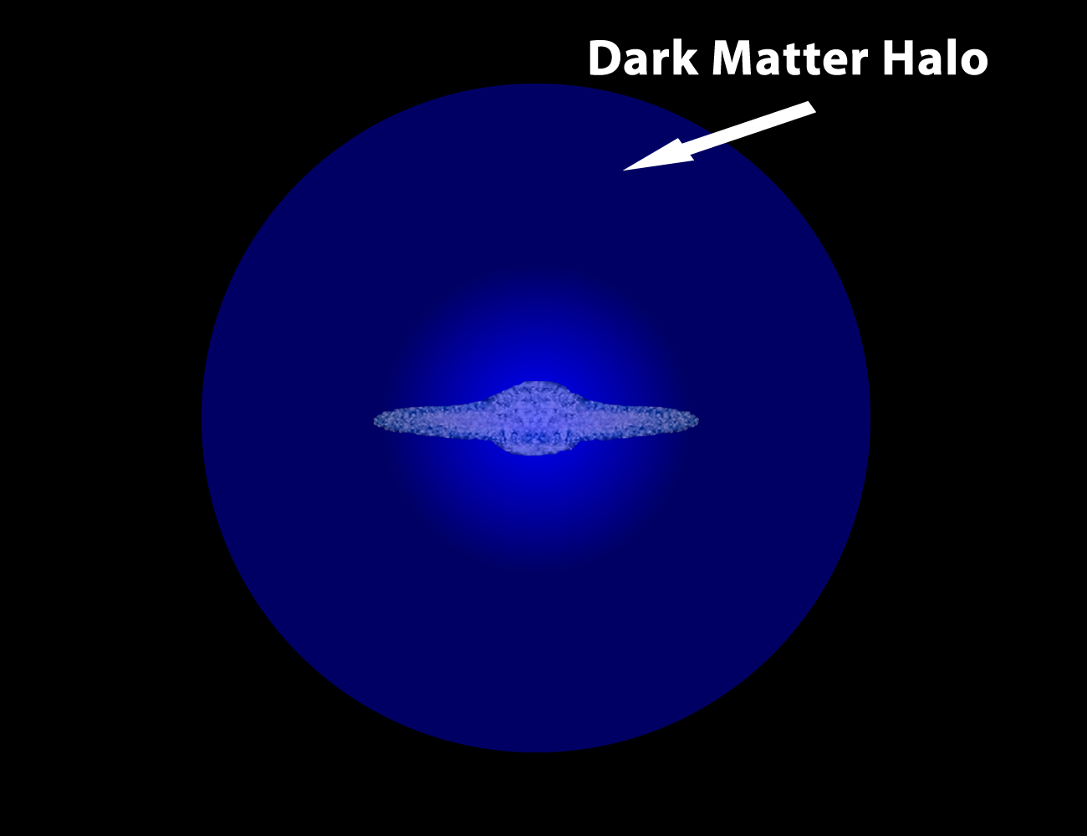
Some Sources of Dark Matter are Cheap
Our Sun is Moving through our Galaxy…
Lots of Dark Matter is hitting the Earth every second
You are here

Slide 13
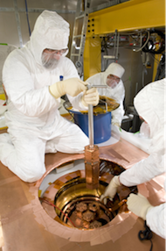
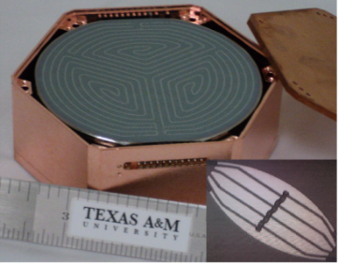
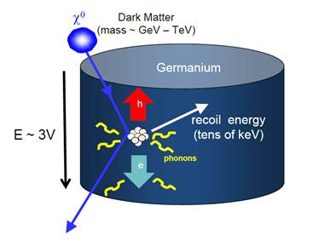
Dark Matter Searches with the CDMS Experiment
Place Superconducting detectors deep underground
Small interaction with a dark matter particle raises the temperature, which changes the resistance, which changes the voltage, which we can measure!
  Currently taking data at Soudan mine (Minnesota)
  Major upgrades underway → Sudbury Neutrino Observatory (SNOLab)

Slide 14

Direct Dark Matter Detection Experiment
(artist in training conception)
Dark Matter
Particle
We saw it! Eureka!
Ping
Atom in Detector
Low Temperature
Detector
https://www.youtube.com/watch?v=Xw-TrHv6vlQ&list=UUvtJz9MYn_lxD4Fd4oTpugQ

Slide 15
Conclusions
It’s an incredibly exciting time to be a scientist!
There is a very real possibility that Astronomy, Cosmology and Particle Physics are all coming together at the right time
Perhaps we understand the role of Dark Matter in the Universe since the Big Bang!
If our understanding is correct, a major discovery may be just around the corner!

Slide 16
Back up slides…

Slide 17
Abstract
High energy physics, and the search for new particles, is in a golden age. With the LHC turning on soon, and ample evidence from telescopes and other astronomical observations that dark matter is likely to be a fundamental particle, a major discovery may be just around the corner. Cosmology may also provide important clues about how this elusive particle was created in the early universe. While there are many current ways in progress to detect it, and determine its nature, none have been successful. In this talk, I’ll take a step back and share thoughts on these searches since every so often it’s useful to consider what we don’t know, and what we know for sure that just ain’t so.

